Slide 1
Cryptocurrency
An Introduction to the World of Cryptocurrency

Slide 2
Group Members
Vrushabh Jambhulkar (B140598CS)
Rahul Menon (B140062CS)
Vipin Santhosh (B140020CS)
Nitin Joes (B140090CS)
M. Sajmal (B140288CS)
Mushfil M. (B140721CS)

Slide 3
Contents
Introduction to cryptocurrency
History. How it started, Who created it, Deep Web connection etc.
Blockchain technology
Different cryptocurrencies and their mining
Economics of Cryptocurrencies
How it works
How are the prices determined
Cryptocurrency policies in different countries.
Effect of demonetization on the Indian bitcoin market.
ICOs and market risk
Compare and contrast with stock market
Disadvantages
Future of cryptocurrency

Slide 4
Introduction

Slide 5
How cryptocurrency began?
Satoshi Nakamoto - Creator of Bitcoin
Announcing the first release of Bitcoin, a new electronic cash system that uses a peer-to-peer network to prevent double-spending. It’s completely decentralized with no server or central authority. – Satoshi Nakamoto, 09 January 2009, announcing Bitcoin on SourceForge.
Basically limited entries in a database no one can change without fulfilling specific conditions

Slide 6
History
Nakamoto published a white paper in 2009 elucidating the concept, technology and source code for implementation of blockchain. Alongside, he introduced Bitcoin, the world’s first cryptocurrency.
The first Bitcoin transaction, made between the cryptocurrency’s elusive creator Satoshi Nakamoto and cybersecurity veteran Hal Finney, came in January 2009.
In 2017, in fact, the number of Bitcoin transactions over a single day regularly exceeded 250,000.
Today, the value of 1 bitcoin is above 3,73,000 rupees

Slide 7
What is Cryptocurrency?
Cryptocurrency is a general name referring to all encrypted decentralized digital currency like Bitcoin.
Cryptocurrency is an encrypted decentralized digital currency transferred between peers and confirmed in a public ledger via a process known as mining.
Cryptocurrency uses cryptography to create coins and secure transactions.
Typically cryptocurrencies are open source with public, but encrypted ledgers of all transactions.

Slide 8
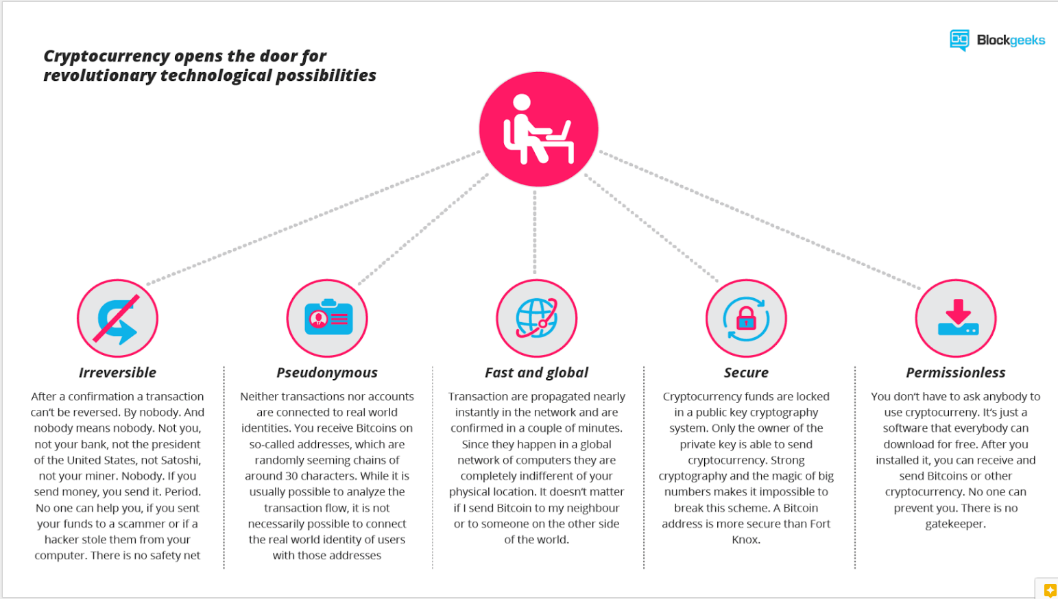

Slide 9
Monetary Properties
Controlled supply:
Most cryptocurrencies limit the supply of the tokens.
In Bitcoin, the supply decreases in time and will reach its final number somewhere in around 2140.
All cryptocurrencies control the supply of the token by a schedule written in the code.
No debt but bearer:
The money on your bank account is created by debt, and the numbers, you see on your ledger represent nothing but debts.
Cryptocurrencies don‘t represent debts.

Slide 10
Blockchain
The public ledger used by cryptocurrency
A blockchain is an anonymous online shared ledger for recording the history of transactions and that cannot be altered.
Blockchain allows users to manipulate the ledger in a secure way without the help of a third party.
A bank's ledger is connected to a centralised network. However, a blockchain is anonymous, protecting the identities of the users.
Blockchain enables two entities that do not know each other to agree that something is true without the need of a third party.

Slide 11
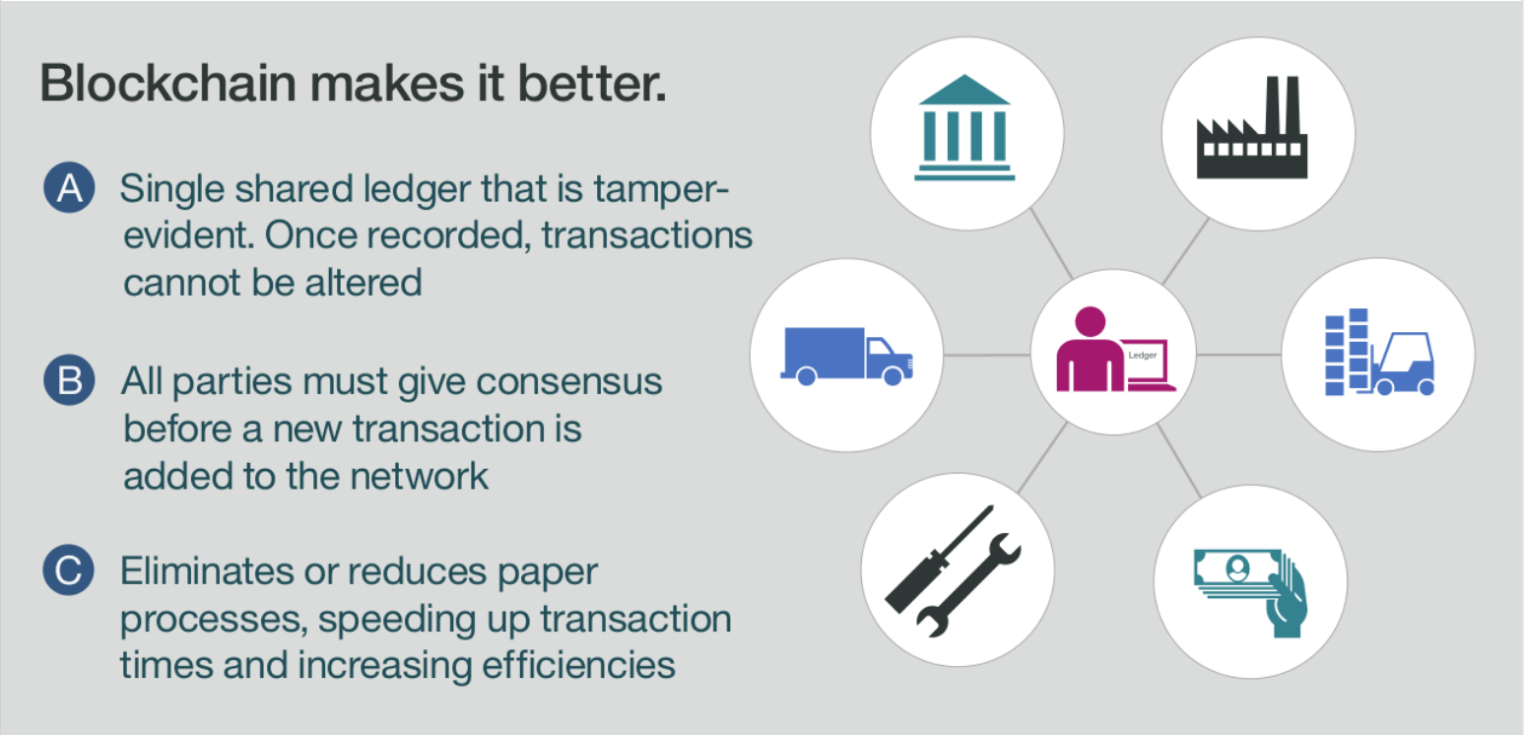

Slide 12
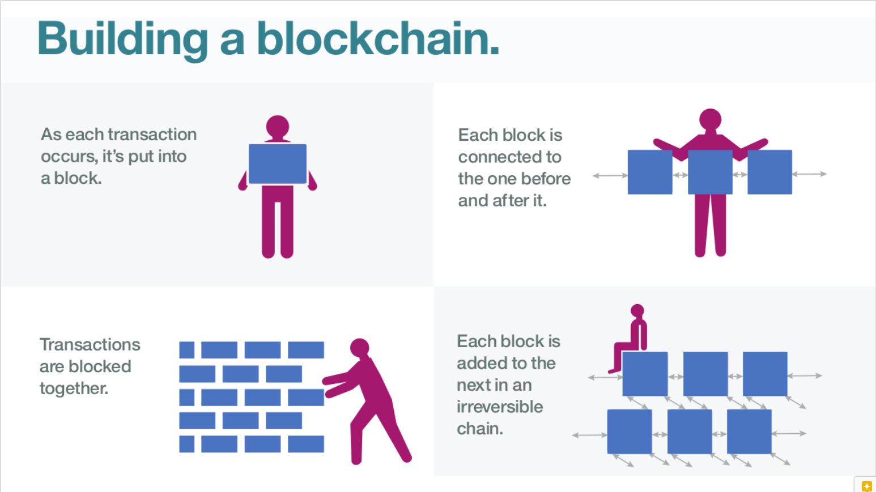

Slide 13
Blockchain
A blockchain is a distributed database that takes a number of inputs and places them into a block.
Each block is then 'chained' to the next block using a cryptographic signature.
This allows blockchains to be used as a ledger which is accessible by anyone with permission to do so.
Use of blockchain technology is not limited to the financial sector.
For example, Honduras government has put all land records on a public ledger - the blockchain. The minute there is a change in ownership, it gets recorded publicly.
The Australian Securities Exchange (ASX) announced this year that it would move Australia's equities clearing and settlement system onto blockchain.

Slide 14
Different cryptocurrencies and their mining

Slide 15
Mining and the power of the decentralization
A miner of a cryptocurrency is a computing node of that cryptocurrency’s network.
A mining has multiple applications depending on the type of cryptocurrency.
Mining nodes on the network solve complex mathematical problems to generate new cryptocurrency.
Process transactions of cryptocurrency to get small fraction of the transaction as a transaction charge as reward.
So miners are responsible for the decentralization aspect of cryptocurrencies.
More miner means a more secure network and higher the number of transactions of the cryptocurrency that is possible.

Slide 16
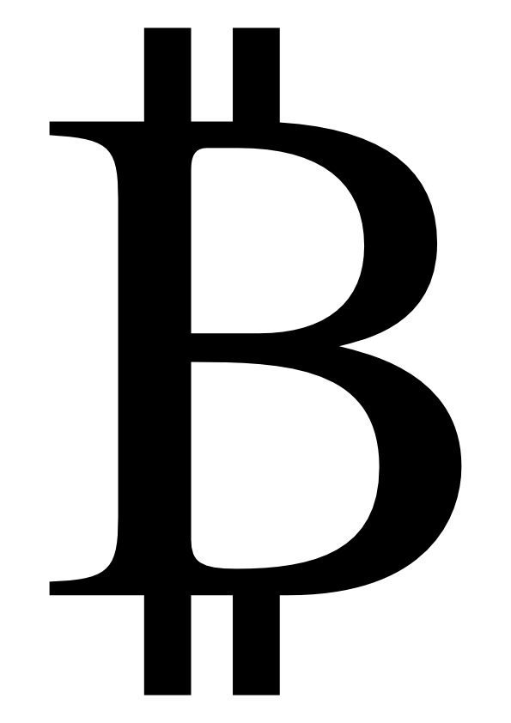
Major Cryptocoins
BitCoin(BTC) ($5,850)
The first decentralized ledger currency. Cryptocurrency with the most famous, popular, notable and highest market capitalization. Private transactions!
Category : Currency
Cons: Slow transactions , high transaction fees , not segwit ready (segregated witness to make space in 1 MB block for faster more efficient transactions)

Slide 17

Major Cryptocoins
Ethereum (ETH) ($298)
A decentralized platform that runs smart contracts: Applications that run exactly as programmed without any downtime, censorship or fraud. Basically programmable currency.
Huge developer community making applications that utilize the platform.
Category: Platform
Cons: higher inflation than bitcon, especially on transaction charges, more complex network.

Slide 18

Major Cryptocoins
Ripple(XRP) ($ 0.2)
Real time gross settlement system.
Supplied by banks as liquidity for cross border transactions
Category: Payment Network
Extremely fast transaction speed. 4 seconds
Con : Founders control around 60% all ripple that exists.

Slide 19

Major Cryptocoins
LiteCoin(LTC) ($ 56)
Similar to bitcoin in functionality, but has faster transaction speeds, lower transaction rates, can handle more transactions than bitcoin and is highly secure.
Category: Currency
If BitCoin is digital gold , LiteCoin is digital silver.
LiteCoin is segwit ready.

Slide 20


Bonus Round
GOLEM(GNT) ($0.20)
Category : Computing Power
Golem is an open source supercomputer that anyone can access. It is made up of the combined power of user latos and large datacenters.
‘Miners’ are paid for leasing out their computing power.
Siacoin(SC) ($0.0038)
Category: Storage network
Sia is decentralized network of datacenters that taken together comprise of the world's largest, cheapest and extremely safe cloud storage platform.
‘Miners’ are paid for renting out storage space. Files are split across storages and each portion is encrypted.

Slide 21
How it works

Slide 22
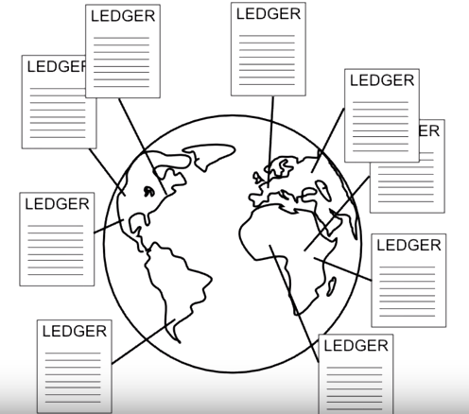
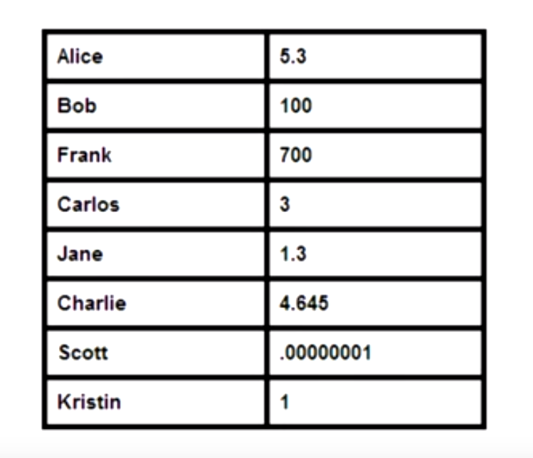
How it works?
What is Bitcoin?
It is a digital file which holds all the accounts and money like a ledger.
A copy of this is maintained on every node in the bitcoin network.

Slide 23
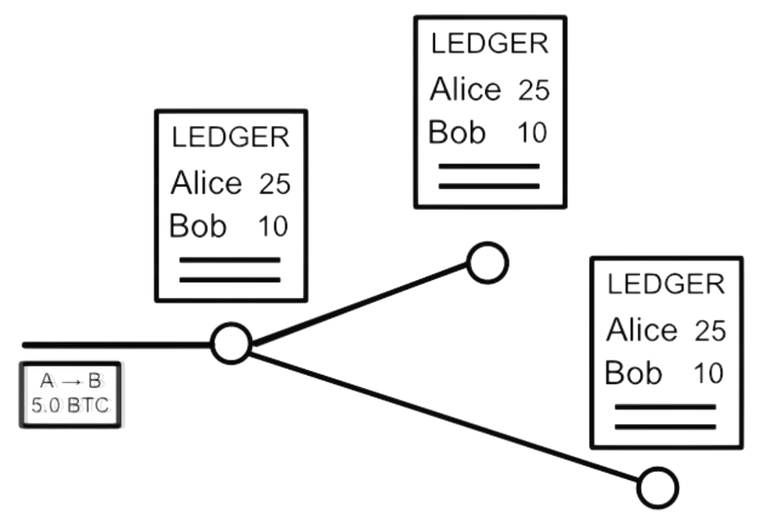
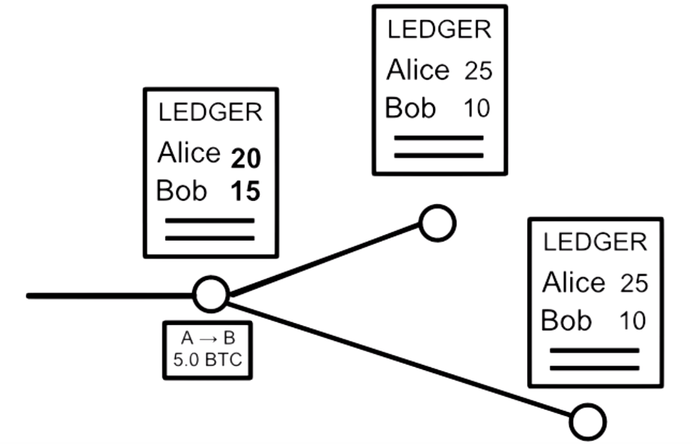
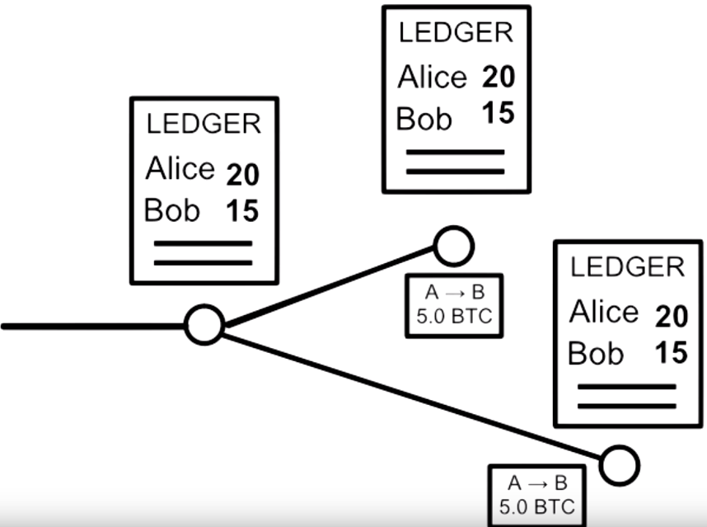
Sending Money
Alice
Bob
5.0 BTC

Slide 24
How it works?
There is no centralized bank, rather it is maintained by a group of people in the network
Everyone knows about everyone else's transactions.
This creates trust issues, to solve this there is unique technique to maintain security in Bitcoins using mathematical functions and cryptography.

Slide 25
Authentication
How can nodes be sure that the transaction request is authentic, that the rightful owner has sent the message.
Solution – Digital Signatures:
It is generated by mathematical algorithms.
This is unique for every transaction.
A Digital Signature is utilize by two different but connected keys
Private Key: a key to create a signature by the sender
Public Key: a key to verify a signature by others, these are the sent to addresses in bitcoins.
This makes every transaction unique, hence difficult to forge.

Slide 26
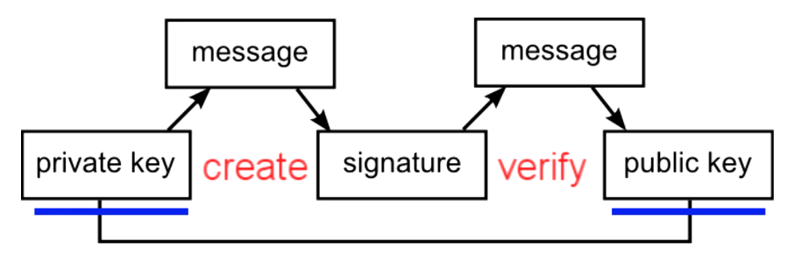
Signature = f(private_key, message);
Verify: 1=? v(Signature, message, public_key);

Slide 27
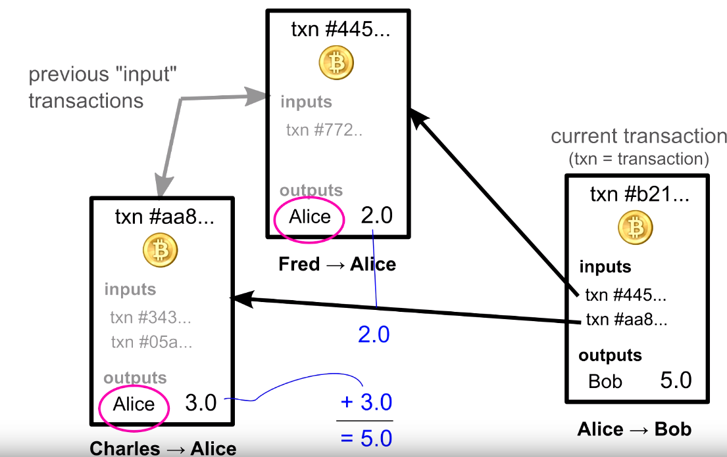
Account Balances?
In practice, no account balances are saved in the ledgers.
Instead list of all the transactions are kept.
The ownership of funds is verified through the links to the previous transactions.
Each transaction can only be used once as an input

Slide 28
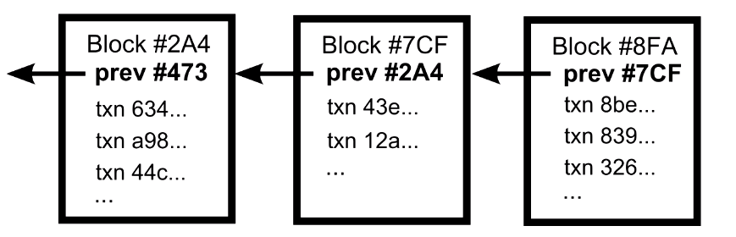
Transaction Order
As all the transactions are passed node by node, there is no guarantee that the order in which you receive them is the order in which they were created.
Nodes need to agree on the transaction order.
Solution – Blockchain
Transactions in the same block are considered to happen at the same time
Any node in the network can take a set of unordered transactions to form a block and broadcast it as a suggestion for the next block in the chain. (problem there can be multiple suggestions)
For every block to be valid, each node has to solve a mathematical puzzle.

Slide 29
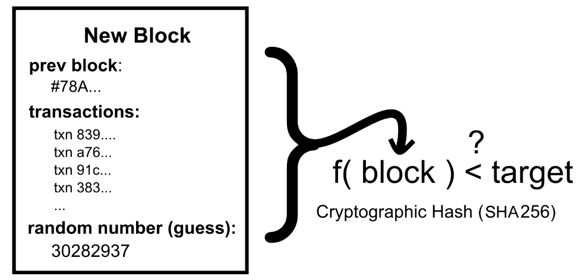
Block Puzzle

Slide 30
BitCoin Generation
Finding solution to these Block puzzle is what the so called Bitcoin Miners do for the most part.
For every right solution for a correct block, a new coin is awarded to the miner who solved it.
Every year the reward limit is cut into half, so after a few years there will be no more creation of coins.
By year 2140, there will 21 million bitcoins and will reach the maximum cap value.

Slide 31
How is the Price determined?
The price of a bitcoin is determined by supply and demand.
There is only a limited number of bitcoins in circulation and new bitcoins are created at a predictable and decreasing rate.
So the demand must follow this level of inflation to keep the price stable.

Slide 32
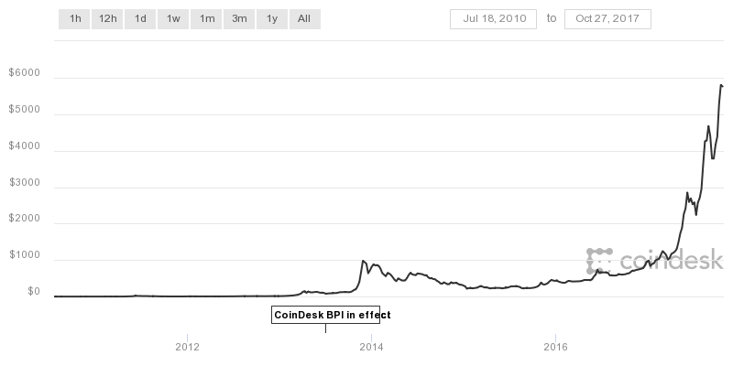
Price Charts
5762.85$
582.93$
0.06$ (Rs. 3.89)

Slide 33
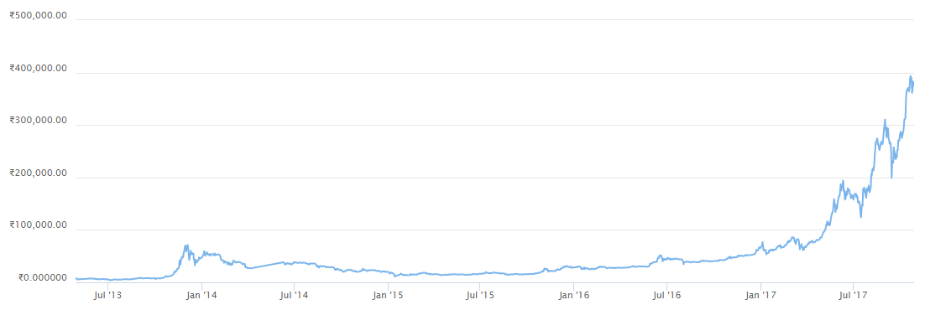
More Charts
Rs. 3,75,876.85
Rs. 4038

Slide 34
Now how many people would like to go back in time and ask yourself to buy some bitcoins??

Slide 35
Bitcoin policies in different countries

Slide 36
Bitcoin policies in different countries
The legal status of bitcoin varies substantially from country to country and is still undefined or changing in many of them
Illegal in Bangladesh, Bolivia, Ecuador & Kyrgyzstan.
Its status as money (or a commodity) varies with differing regulatory implications.

Slide 37
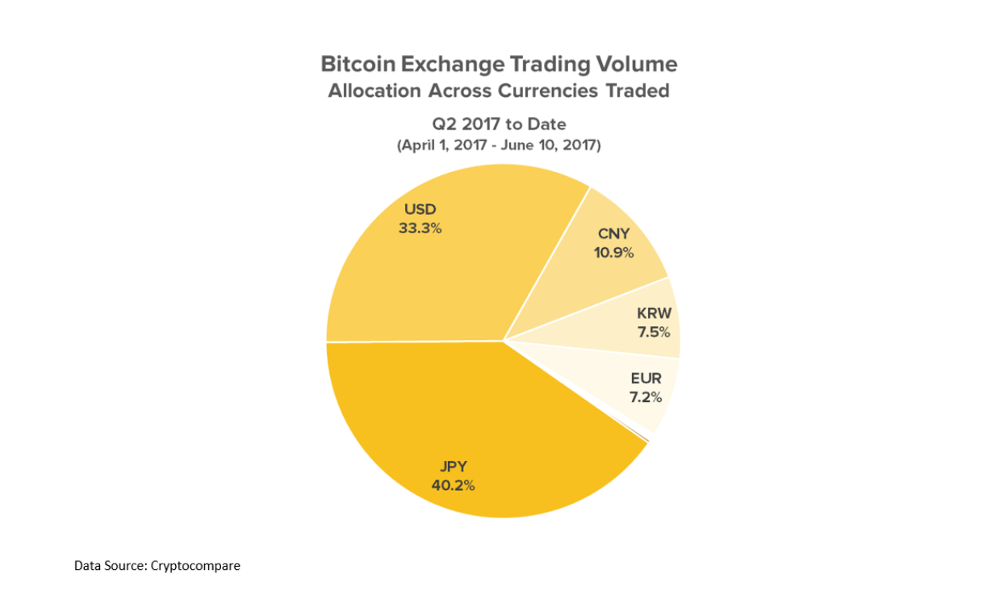

Slide 38
United States
The US Treasury classifies bitcoin as a convertible decentralized virtual currency.
The IRS treats all digital currencies as Capital assets and are therefore subject to capital gain tax.
Any disposition of these currencies is a tax event.
Mining is considered as immediate income.

Slide 39
Japan, China
Japan officially recognizes bitcoin and digital currencies as a "means of payment that is not a legal currency".
Japan have eliminated the consumption tax on Bitcoin trading on April 1,2017 when it officially declared Bitcoin as a legal tender
China banned ICOs and bitcoin exchanges in the first week of September. Caused a fall in bitcoin prices.
Market is making a comeback as of September 24th.

Slide 40
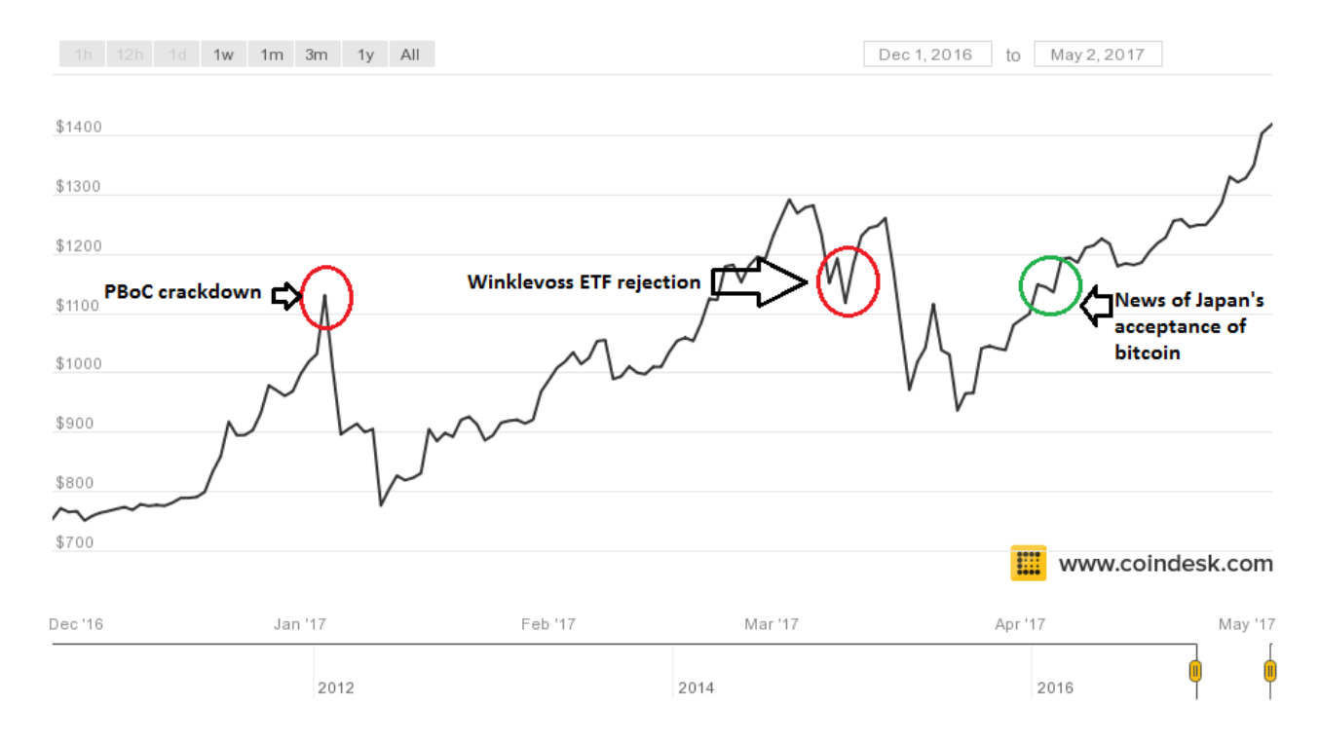

Slide 41
India
Bitcoin is not yet legalized in India. But it's also not illegal.
During the time when bitcoin was picking up pace in China, Indians struggled to transfer money to the overseas Bitcoin exchanges.
Things changed drastically after the demonetisation drive.
In the panic, Indian residents turned to Bitcoin.

Slide 42
India..
18 days after the demonetization speech of PM Narendra Modi, the price of bitcoins had surged from $757 to $1,020 (per bitcoin), whereas in the U.S. bitcoins are trending at $770 apiece.
20 – 30k new users per month. Multiple apps such as Zebpay, unocoin etc.
A decision regarding the legal status of bitcoins in India will be made based on the examination results of an inter-disciplinary committee .
Tax consultants and experts believe that the sale profits shall be taxed as Capital gains similar to the gains made from investments in Stocks and Shares.

Slide 43
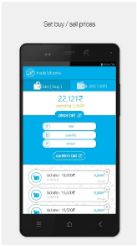
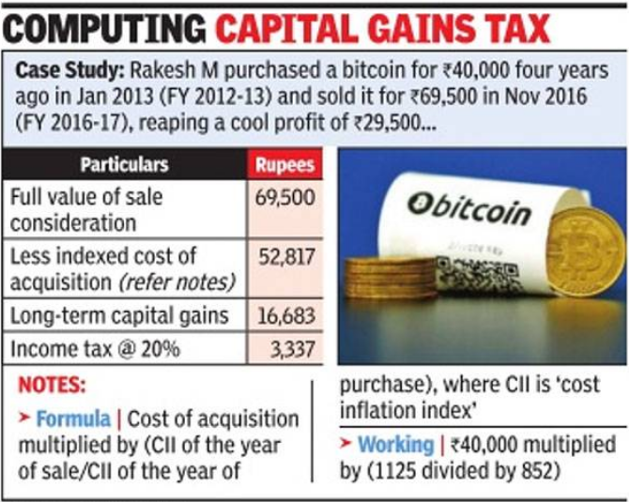


Slide 44
ICOs and Market risks

Slide 45
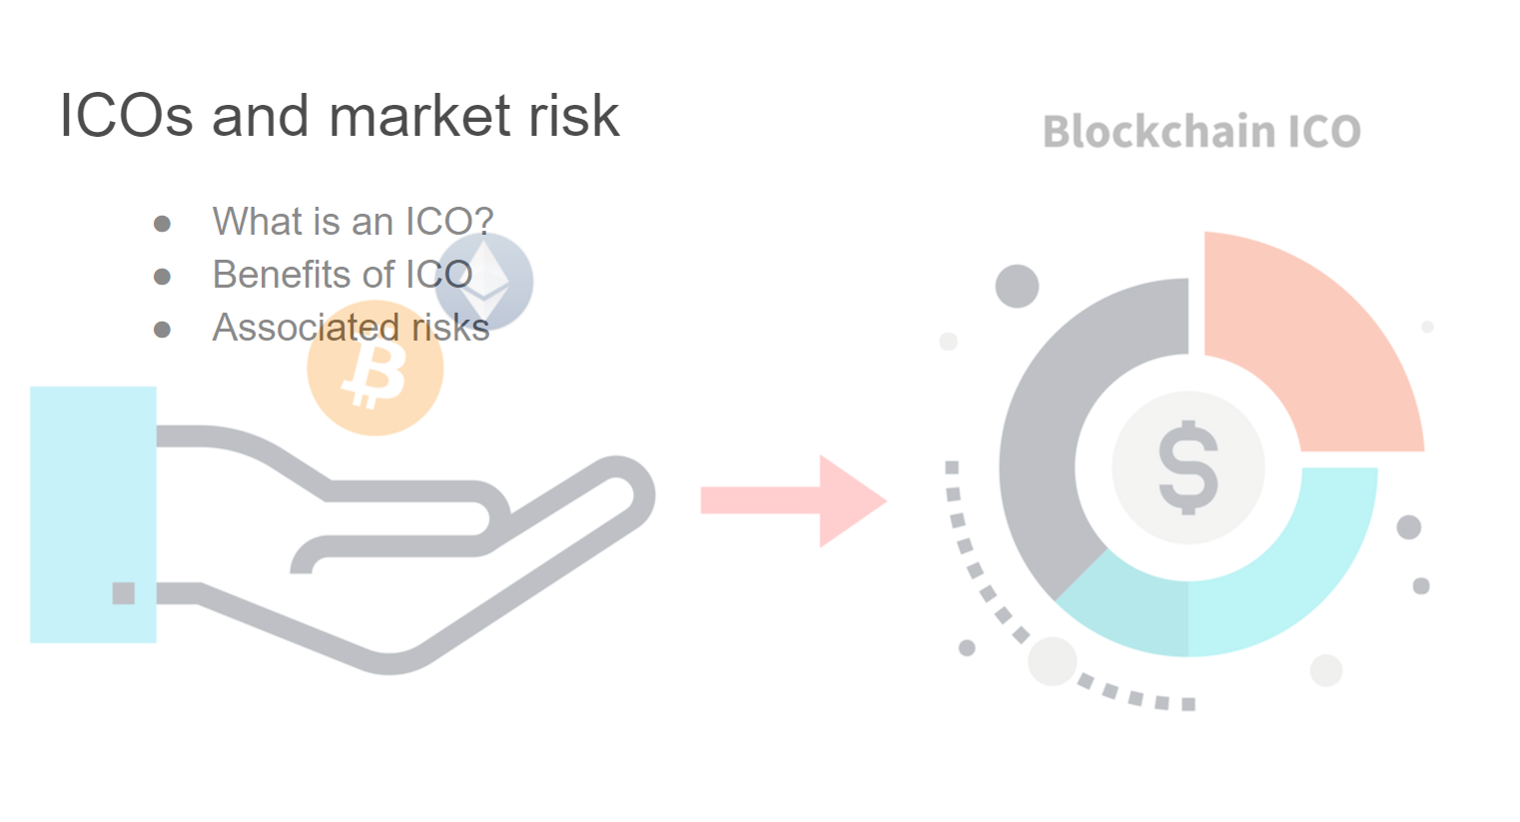

Slide 46
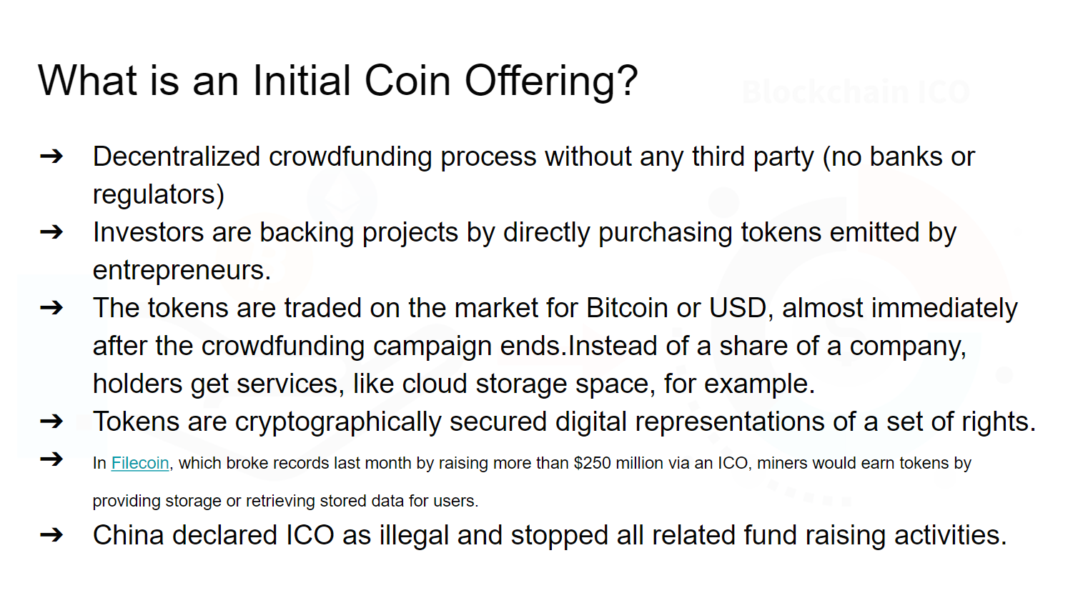

Slide 47
Benefits of an ICO?
Fast and easy fundraising mechanism since anyone can initiate an ICO and customized tokens can be easily generated
Democratizing investment.The ICO method generally allows anyone in any geography to raise money. It also generally permits anyone to contribute.
Primarily online marketing. Tokens can be marketed over the internet to a large, general audience.
Settlements over the blockchain. Confirming contributions and distributing tokens simply requires monitoring and updating the distributed digital ledgers.
Potential for gains. Cryptocurrencies can appreciate quickly in price.Investors hope to find a token that can be “the next bitcoin” in terms of economic appreciation.

Slide 48
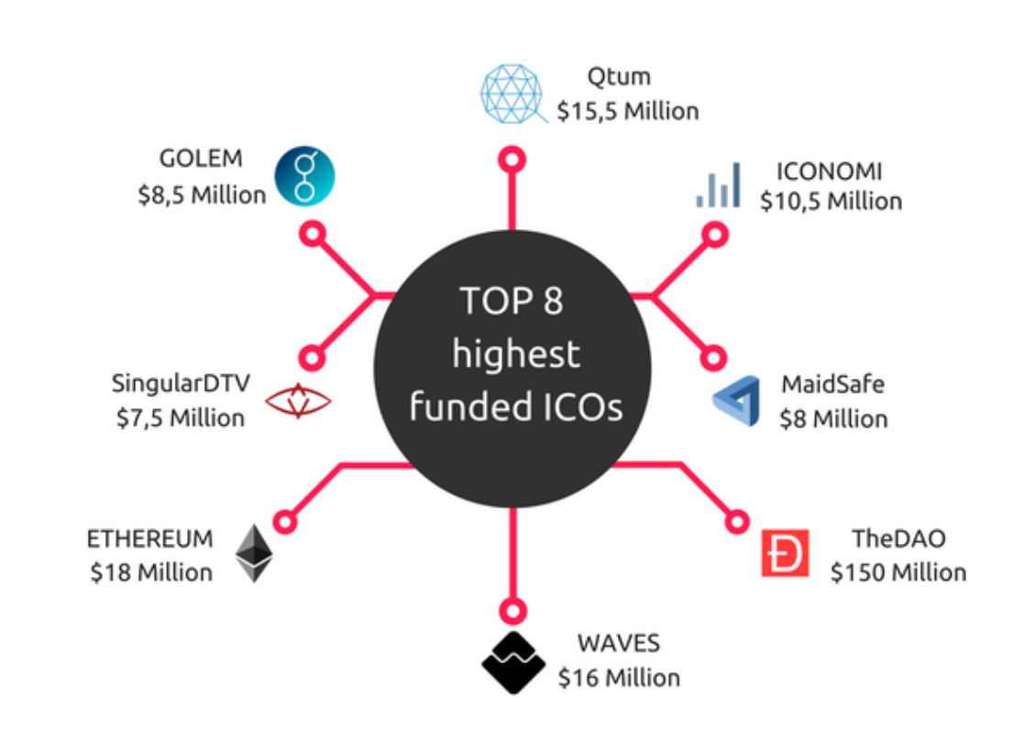

Slide 49
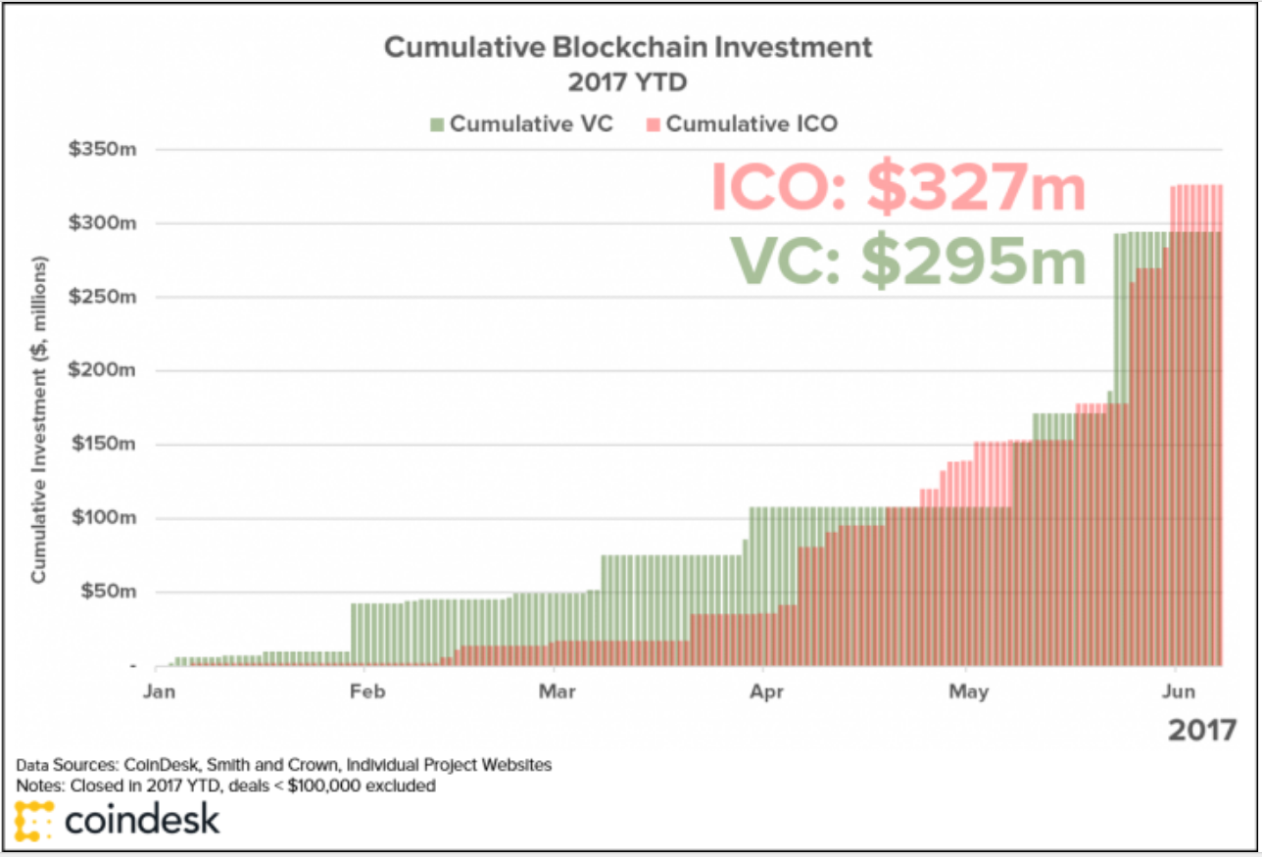

Slide 50
Risks associated with ICOs
ICOs come with no legal claim to ownership, so you're truly at the whim of the issuer.
90% of the ICO funded companies fail to deliver. Many of the companies launching ICOs haven’t produced anything more than a technical whitepaper describing an idea that may not pan out.
Extreme price volatility. High-price volatility translates to high risk for token investors and could be a reflection of underlying market manipulation.
Market manipulation. The market for tokens could be manipulated in multiple ways. Some possible ways include pumping and dumping,
SEC warned investors to watch out for ICO scams. an estimated 10 percent of money intended for ICOs looted away by scams such as phishing this year,

Slide 51
Disadvantages
BASIC ISSUES, RISKS & FAILURE:CONSUMER, LEGAL ISSUES

Slide 52
BASIC ISSUES
Price volatility
Price change will reflect how adopted the technology is.
Market cap in 2020 will surely exceed current numbers.
It’s impossible to predict which related businesses will be successful.
There is no central bank for Bitcoin.

Slide 53
No Valuation Guarantee
If a large group of merchants decide to “dump” Bitcoins and leave the system, its valuation will decrease greatly which will immensely hurt users who have a large amount of wealth invested in Bitcoins. The decentralized nature of bitcoin is both a curse and blessing.

Slide 54
RISKS & FAILURE:CONSUMER
Wallets Can Be Lost
If a hard drive crashes, or a virus corrupts data , and the wallet file is corrupted, Bitcoins have essentially been “lost”.
The coins the investor owned will also be permanently orphaned.
Irreversible Payment
There’s no center point in payment processing so if you transfer someone by mistake and want to get a refund for services there’s no option to dispute that person.

Slide 55
RISKS & FAILURE:CONSUMER
Hackers
Cryptocurrencies are targets for highly sophisticated hackers,who have been able to breach advanced security systems.
Scams
Cheat people with Fake oppurtunity.
Digital QR codes make it vulnerable to theft.

Slide 56
LEGAL ISSUES
Purchase of illegal goods
Site such as “Silk Road” offer many goods such as drugs and fake ID’s.
Supporting Criminal activity
Launder money from illegal activity and purchase illegal services
Bitcoins Are Not Widely Accepted
Possibility that governments might force merchants to not use Bitcoins to ensure that users transactions can be tracked.
India’s Supreme Court demanded the government and the Reserve Bank of India to check bitcoin transactions so as to ensure they aren’t used for money laundering or terrorism funding.
Takes away from the ability of the government to generate revenue through taxation.

Slide 57
A Final word on that…
Crime is bad! Tax evasion is bad!,
But sometimes governments are bad too!

Slide 58
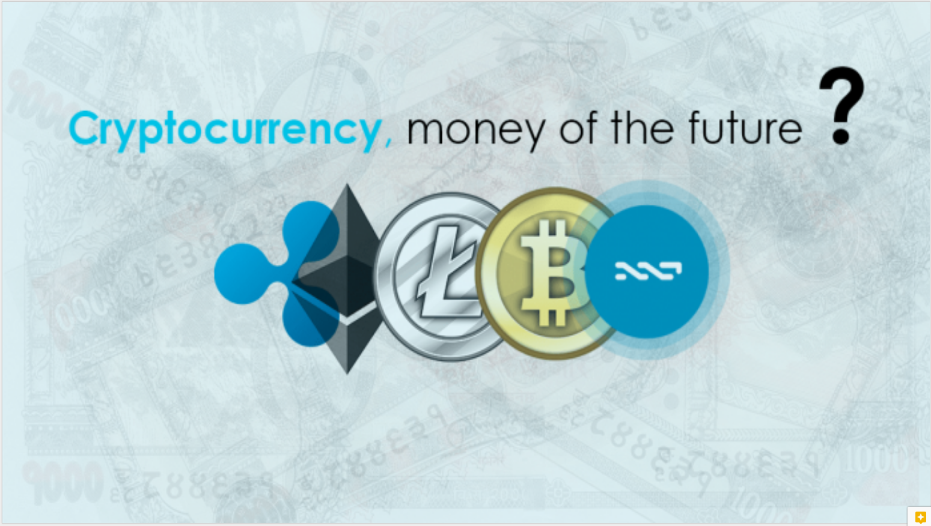

Slide 59
Future
Why it may FAIL, Why it may SUCCEED

Slide 60
May be FAILED
Possibility that governments might force merchants to not use Bitcoins
Hackers create security problem
Protocol attacks -Banks and all
consumers insecurity

Slide 61
Why it may succeed?
These years cryptocurrency is growing so fast. So it is truly possible that it can be the money of the future
For a worldwide economy, it is the solution
Developed by using modern secured technology.
Government make it as a legal one.
Helps basic imports and exports with transactional currency
It helps Companies to pay suppliers.
Six of the world’s largest banks led by UBS (NYSE:UBS) and some others that have signed on are teaming up to create and accept a utility settlement coin - a new cryptocurrency.

Slide 62
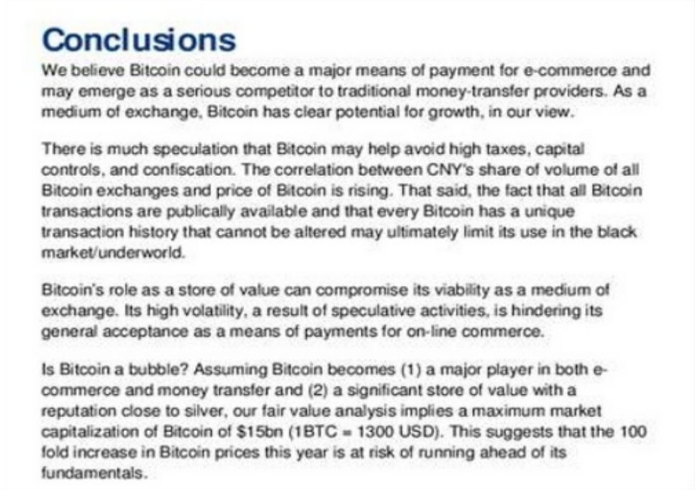
BANK OF AMERICA MERRYL FINCH-INVESTMENT AND CORPORATE BANK

Slide 63
Thank You

